Slide 1

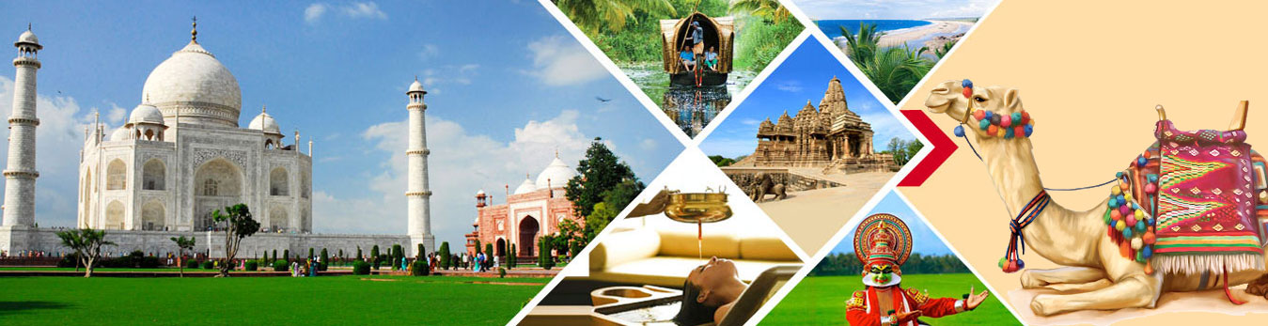
Presentation on Tours and Travel Website
Prepared By:
Debadrita Paul
I.T.Vedant

Slide 2

Overview
Introduction
Technical Details
Website Pages
Conclusion

Slide 3
Introduction
The main objective of our project:
User can easily get details of particular tourist place with proper day to day tour plan and send in enquiry through contact details provided.

Slide 4
Technical Details
The front-end website is designed using HTML5,CSS3,Boostrap,JavaScript.
The website is made flexible and responsive with the use of JavaScript API

Slide 5
Website Pages

Slide 6
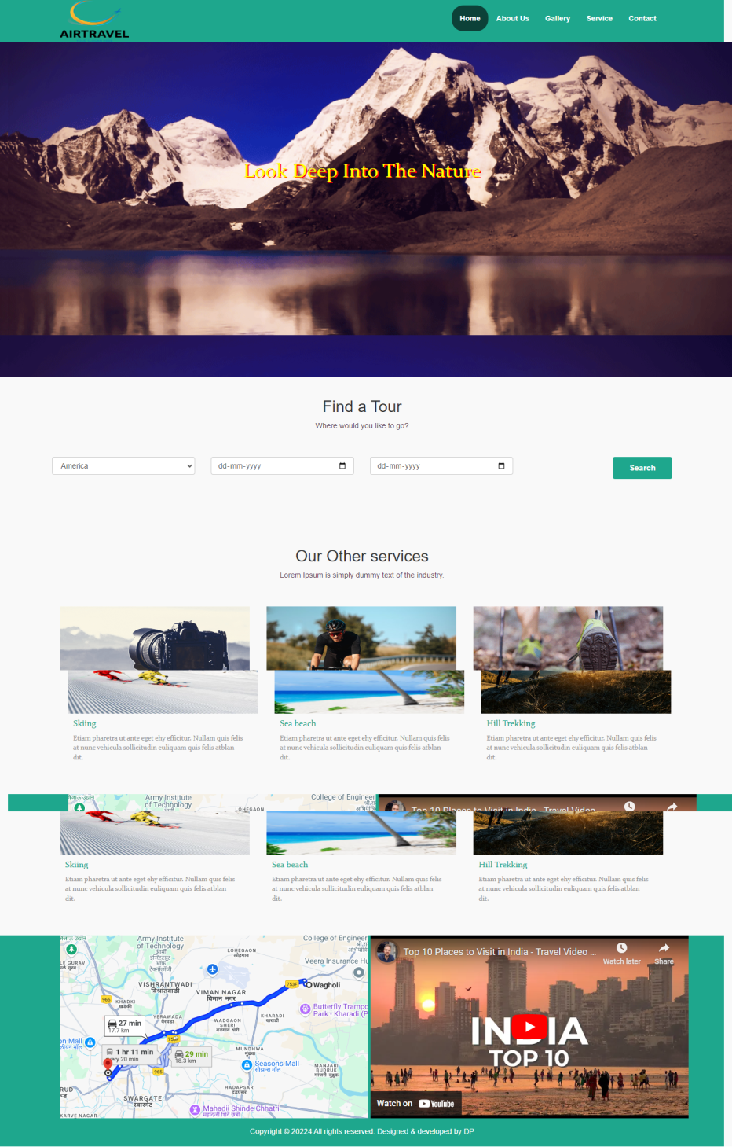
Home Page

Slide 7
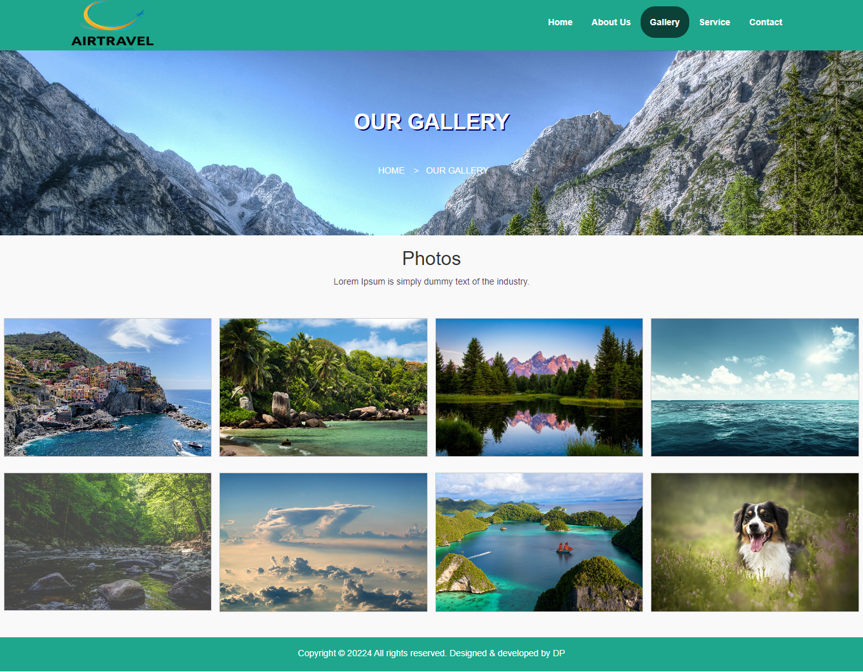
Gallery Page

Slide 8
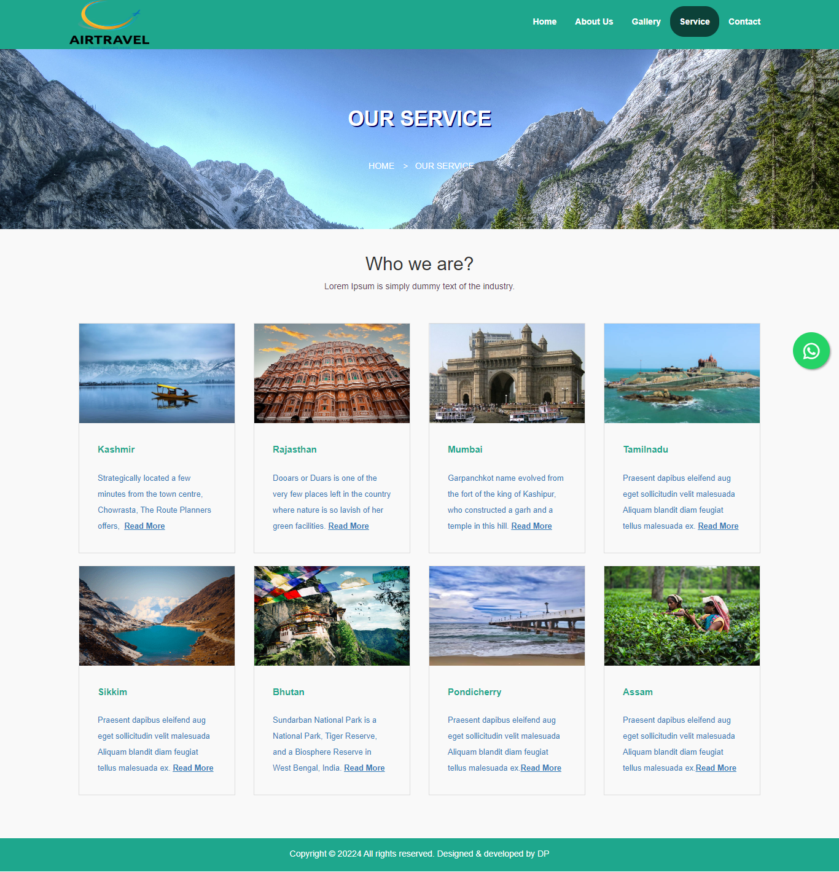
Service Page

Slide 9
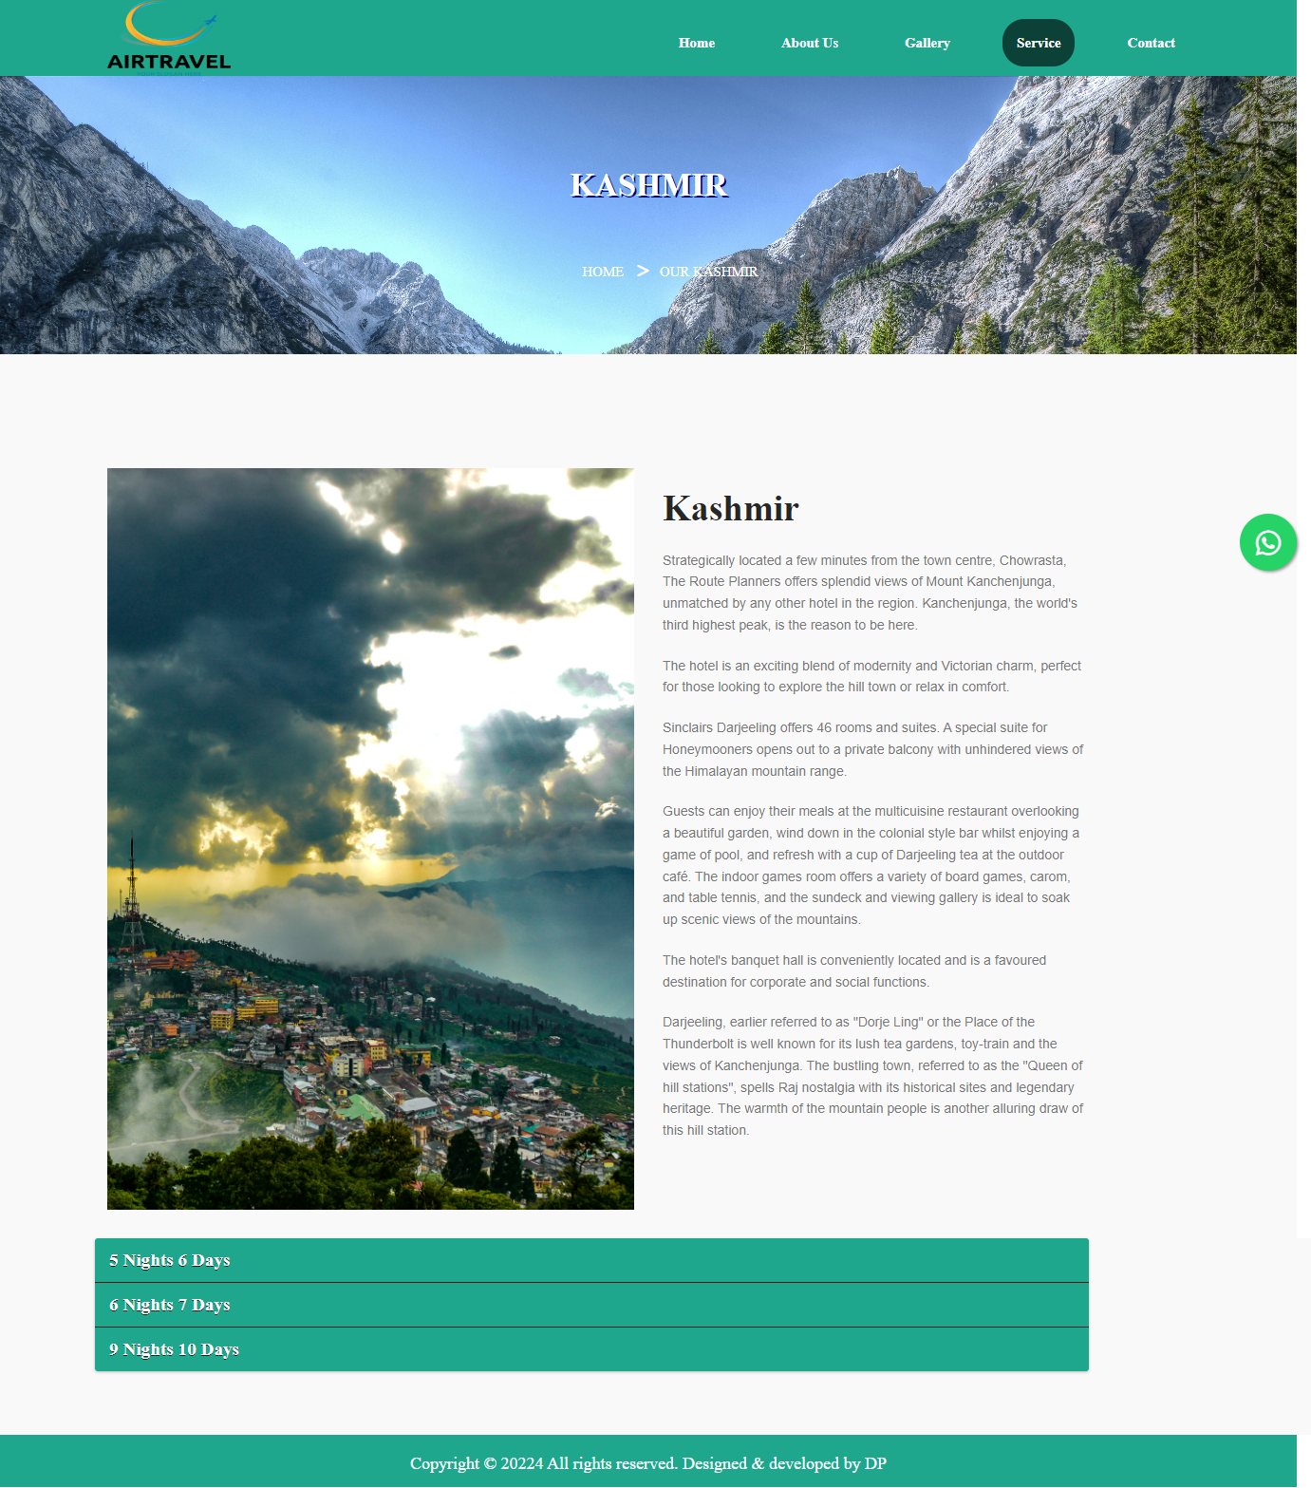
Service Details Page

Slide 10
Conclusion
In this fast world people are busy with their work and they don’t want to waste time to book offline tickets. Which is very stressful and time consuming and to overcome this problem I have made a Travel Booking website.
Our travel booking website is very user friendly and easy to use.
It requires only few information to book tickets from my website for travelling.

Slide 11

Thank You

